Slide 1
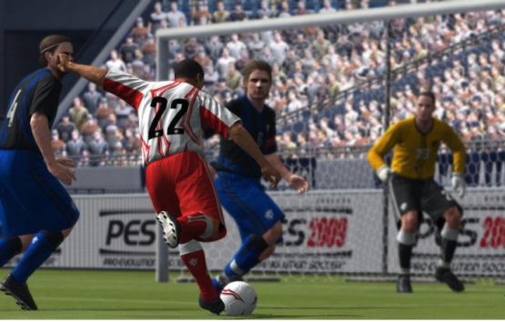
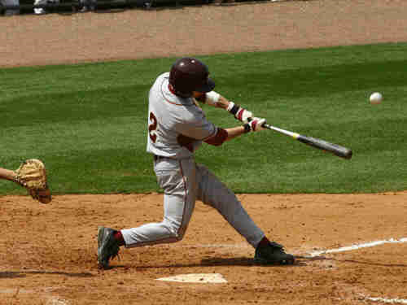
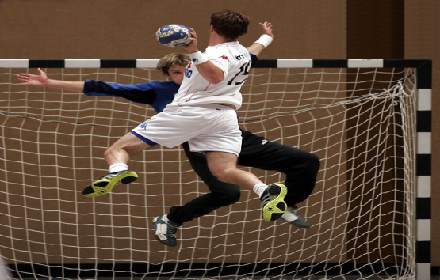
All three events are closely connected to each other
soccer
baseball
handball

Slide 2
All three events are closely connected to each other
Dinner party
Birthday party
Cocktail party

Slide 3
English has been exported from Great Britain into a lot of countries
English
USA
Canada
Australia
New Zealand

Slide 4
English has been exported from Great Britain into a lot of countries
Canada
USA
Australia
New Zealand
English spoken in...

